Slide 1
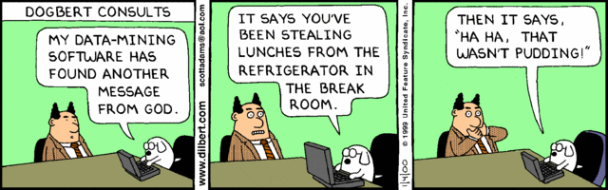

Classification - Basic Concepts
Lecture Notes for Chapter 4
Slides by Tan, Steinbach, Kumar adapted by Michael Hahsler
Look for accompanying R code on the course web site.

Slide 2

Topics
Introduction
Decision Trees
Overview
Tree Induction
Overfitting and other Practical Issues
Model Evaluation
Metrics for Performance Evaluation
Methods to Obtain Reliable Estimates
Model Comparison (Relative Performance)
Feature Selection
Class Imbalance

Slide 3
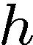
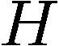
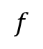

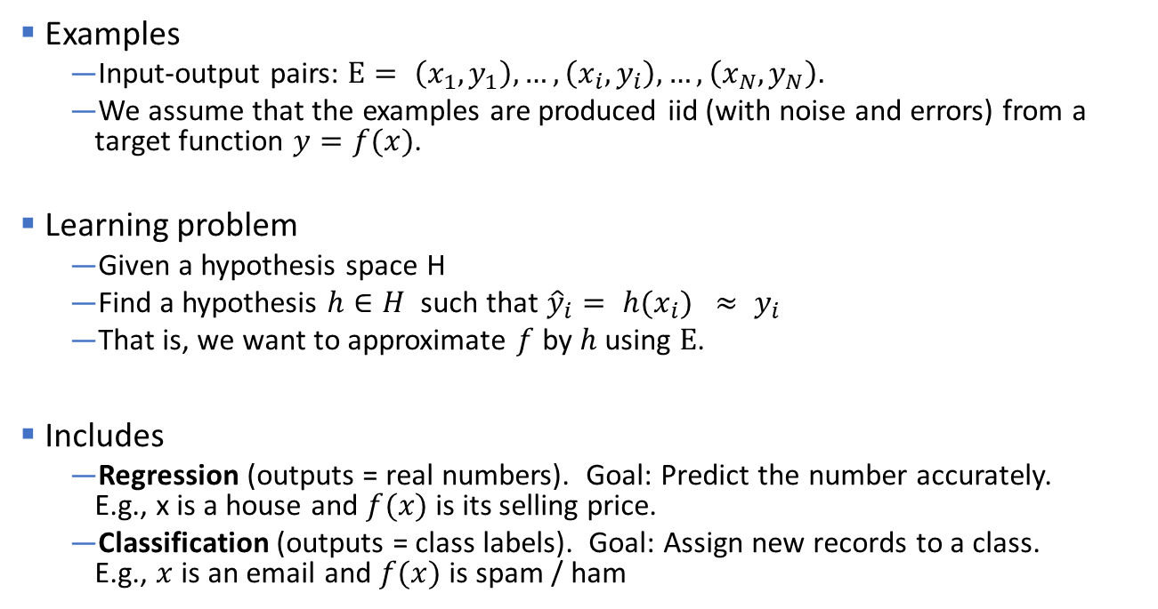
Supervised Learning
Examples
Input-output pairs: $E= \left(x_{1},y_{1}\right),…, \left(x_{i}, y_{i}\right),…,\left(x_{N},y_{N}\right).$
We assume that the examples are produced iid (with noise and errors) from a target function $y=f(x)$.
Learning problem
Given a hypothesis space H
Find a hypothesis $h∈H$ such that ${\hat{y}}_{i}= h(x_{i}) ≈ y_{i}$
That is, we want to approximate $f$ by $h$ using $E$.
Includes
Regression (outputs = real numbers). Goal: Predict the number accurately. E.g., x is a house and $f(x)$ is its selling price.
Classification (outputs = class labels). Goal: Assign new records to a class. E.g., $x$ is an email and $f(x)$ is spam / ham
$$f$$
$$f$$
You already know linear regression. We focus on Classification.

Slide 4
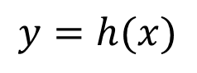
Illustrating Classification Task
E
x
y
$$y=h(x)$$

Slide 5
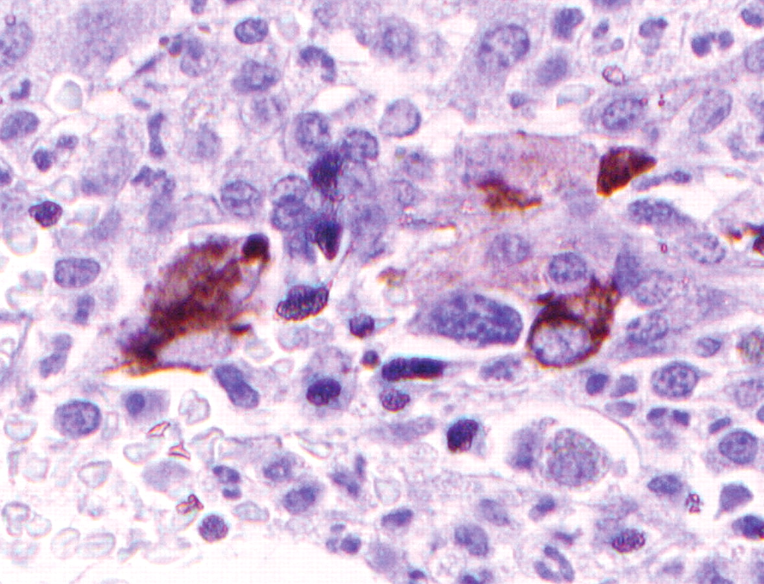
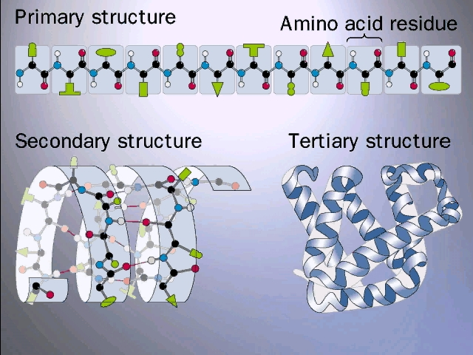
Examples of Classification Task
Predicting tumor cells as benign or malignant
Classifying credit card transactions as legitimate or fraudulent
Classifying secondary structures of protein as alpha-helix, beta-sheet, or random coil
Categorizing news stories as finance, weather, enter- tainment, sports, etc

Slide 6
Classification Techniques
Decision Tree based Methods
Rule-based Methods
Memory based reasoning
Neural Networks / Deep Learning
Naïve Bayes and Bayesian Belief Networks
Support Vector Machines

Slide 7
Topics
Introduction
Decision Trees
Overview
Tree Induction
Overfitting and other Practical Issues
Model Evaluation
Metrics for Performance Evaluation
Methods to Obtain Reliable Estimates
Model Comparison (Relative Performance)
Feature Selection
Class Imbalance

Slide 8
Example of a Decision Tree
categorical
categorical
continuous
class
Splitting Attributes
Refund
Yes
No
NO
MarSt
Induction
Single, Divorced
Married
TaxInc
NO
< 80K
> 80K
NO
YES
Training Data
Model: Decision Tree

Slide 9
Another Example of Decision Tree
categorical
categorical
continuous
class
MarSt
Single, Divorced
Married
NO
Refund
Yes
No
NO
TaxInc
< 80K
> 80K
Induction
NO
YES
There could be more than one tree that fits the same data!

Slide 10
Decision Tree: Deduction
Decision Tree

Slide 11
Apply Model to Test Data
Test Data
Start from the root of tree.
Refund
Yes
No
NO
MarSt
Single, Divorced
Married
TaxInc
NO
< 80K
> 80K
NO
YES

Slide 12
Apply Model to Test Data
Test Data
Refund
Yes
No
NO
MarSt
Single, Divorced
Married
TaxInc
NO
< 80K
> 80K
NO
YES

Slide 13
Apply Model to Test Data
Test Data
Refund
Yes
No
NO
MarSt
Single, Divorced
Married
TaxInc
NO
< 80K
> 80K
NO
YES

Slide 14
Apply Model to Test Data
Test Data
Refund
Yes
No
NO
MarSt
Single, Divorced
Married
TaxInc
NO
< 80K
> 80K
NO
YES

Slide 15
Apply Model to Test Data
Test Data
Refund
Yes
No
NO
MarSt
Single, Divorced
Married
TaxInc
NO
< 80K
> 80K
NO
YES

Slide 16
Apply Model to Test Data
Test Data
Refund
Yes
No
NO
MarSt
Single, Divorced
Married
Assign Cheat to “No”
TaxInc
NO
< 80K
> 80K
NO
YES

Slide 17
Topics
Introduction
Decision Trees
Overview
Tree Induction
Overfitting and other Practical Issues
Model Evaluation
Metrics for Performance Evaluation
Methods to Obtain Reliable Estimates
Model Comparison (Relative Performance)
Feature Selection
Class Imbalance

Slide 18
Decision Tree: Induction
Decision Tree

Slide 19
Decision Tree Induction
Many Algorithms:
Hunt’s Algorithm (one of the earliest)
CART (Classification And Regression Tree)
ID3, C4.5, C5.0 (by Ross Quinlan, information gain)
CHAID (CHi-squared Automatic Interaction Detection)
MARS (Improvement for numerical features)
SLIQ, SPRINT
Conditional Inference Trees (recursive partitioning using statistical tests)

Slide 20
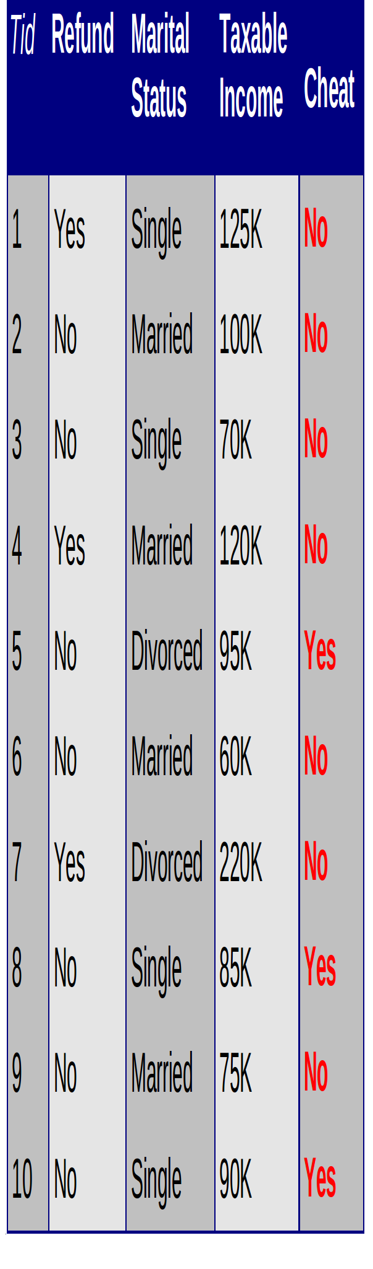
Hunt’s Algorithm
"Use attributes to split the data recursively, till each split contains only a single class."
Refund
mixed
Yes
No
Don’t
Cheat
mixed
Refund
Refund
Yes
No
Yes
No
Don’t
Cheat
Marital
Status
Don’t
Cheat
Marital
Status
Single,
Divorced
Married
Single,
Divorced
Married
Taxable
Income
Don’t
Cheat
mixed
Don’t
Cheat
< 80K
>= 80K
Don’t
Cheat
Cheat

Slide 21
Example 2: Creating a Decision Tree
x2
x
x
x
o
x
x
o
x
x
x
o
o
o
o
o
o
o
0
x1

Slide 22
Example 2: Creating a Decision Tree
x2
X2 < 2.5
x
x
Yes
No
x
o
x
Blue circle
Mixed
x
o
x
x
x
2.5
o
o
o
o
o
o
o
0
x1

Slide 23
Example 2: Creating a Decision Tree
x2
X2 < 2.5
x
x
Yes
No
x
o
x
Blue circle
Mixed
x
o
x
x
x
2.5
o
o
o
o
o
o
o
pure
0
x1

Slide 24
Example 2: Creating a Decision Tree
x2
X2 < 2.5
x
x
x
Yes
No
x
o
x
Blue circle
X1 < 2
x
o
x
x
x
2.5
Yes
No
o
o
o
o
o
o
o
Blue circle
Red X
o
o
0
2
x1
2

Slide 25
Tree Induction
Greedy strategy
Split the records based on an attribute test that optimizes a certain criterion.
Issues
Determine how to split the record using different attribute types.
How to determine the best split?
Determine when to stop splitting

Slide 26
Tree Induction
Greedy strategy
Split the records based on an attribute test that optimizes a certain criterion.
Issues
Determine how to split the record using different attribute types.
How to determine the best split?
Determine when to stop splitting

Slide 27
How to Specify Test Condition?
Depends on attribute types
Nominal
Ordinal
Continuous (interval/ratio)

Slide 28
Splitting Based on Nominal Attributes
Nominal Attribute: Divides values into two subsets. Need to find optimal partitioning.
Ordinal Atribute: Divides values into two subsets. Need to find optimal partitioning.
What about this split?
CarType
CarType
{Sports, Luxury}
OR
{Family, Luxury}
{Family}
{Sports}
Size
Size
{Small, Medium}
OR
{Medium, Large}
{Large}
{Small}
Size
{Small, Large}
{Medium}

Slide 29
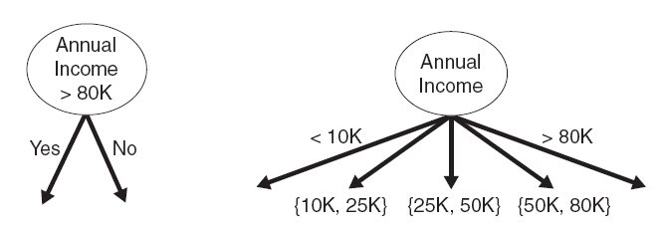
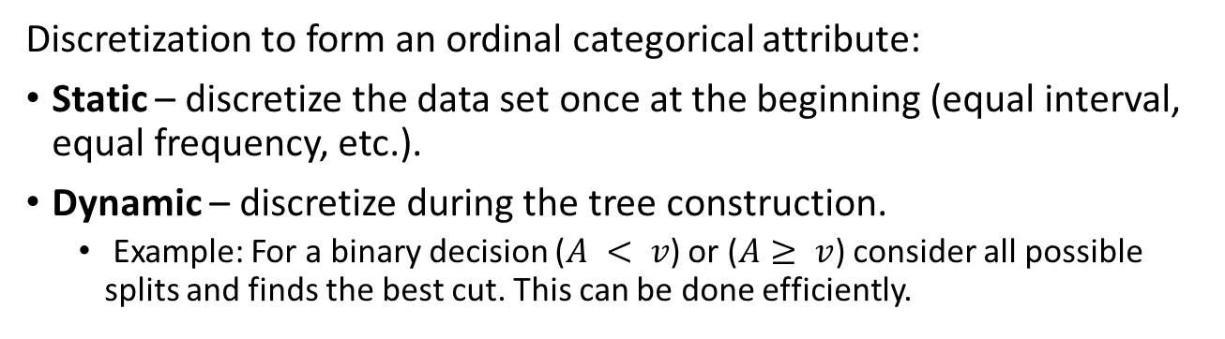
Splitting Based on Continuous Attributes
Binary split Multi-way split
Discretization to form an ordinal categorical attribute:
Static – discretize the data set once at the beginning (equal interval, equal frequency, etc.).
Dynamic – discretize during the tree construction.
Example: For a binary decision ($A < v$) or ($A≥ v$) consider all possible splits and finds the best cut. This can be done efficiently.

Slide 30
Tree Induction
Greedy strategy
Split the records based on an attribute test that optimizes a certain criterion.
Issues
Determine how to split the record using different attribute types.
How to determine the best split?
Determine when to stop splitting

Slide 31
How to determine the Best Split
C0: 10 C1: 10
Before Splitting: 10 records of class 0, 10 records of class 1
Which test condition is the best?

Slide 32
How to determine the Best Split
Greedy approach:
Nodes with homogeneous class distribution are preferred
Need a measure of node impurity:
Non-homogeneous,
High degree of impurity
Homogeneous,
Low degree of impurity

Slide 33
Find the Best Split -General Framework
Assume we have a measure M that tells us how "pure" a node is.
Before Splitting:
M0
Attribute A
Attribute B
Yes
No
Yes
No
Node N1
Node N2
Node N3
Node N4
M1
M2
M3
M4
M12
M34
Gain = M0 – M12 vs M0 – M34 → Choose best split

Slide 34
Measures of Node Impurity
Gini Index
Entropy
Classification error

Slide 35
Measures of Node Impurity
Gini Index
Entropy
Classification error

Slide 36
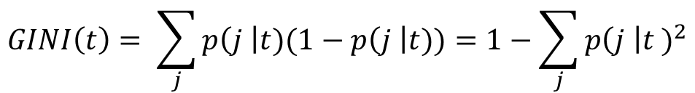
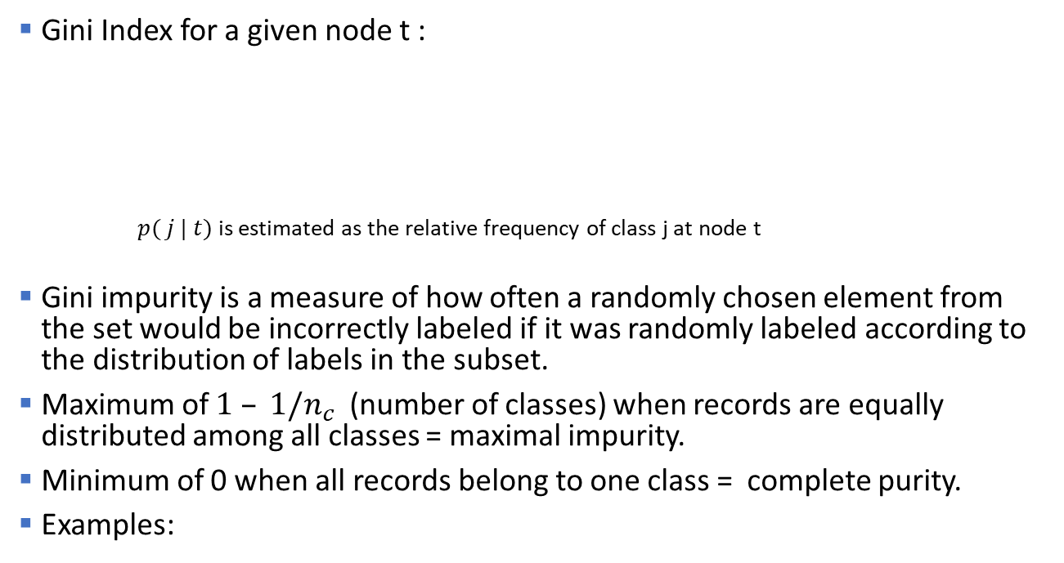
Measure of Impurity: GINI
Gini Index for a given node t :
$p( j | t)$is estimated as the relative frequency of class j at node t
Gini impurity is a measure of how often a randomly chosen element from the set would be incorrectly labeled if it was randomly labeled according to the distribution of labels in the subset.
Maximum of $1 – 1/n_{c}$(number of classes) when records are equally distributed among all classes = maximal impurity.
Minimum of 0 when all records belong to one class = complete purity.
Examples:
$$GINI\left(t\right)= \sum_{j}{p\left(j \right|t)(1−p\left(j \right|t))}=1−\sum_{j}{{p\left(j \right|t )}^{2}}$$

Slide 37
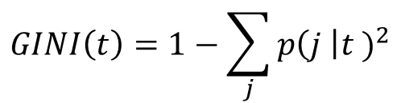
Examples for computing GINI
$$GINI\left(t\right)=1−\sum_{j}{{p\left(j \right|t )}^{2}}$$
P(C1) = 0/6 = 0 P(C2) = 6/6 = 1
Gini = 1 – P(C1)² – P(C2)² = 1 – 0 – 1 = 0
P(C1) = 1/6 P(C2) = 5/6
Gini = 1 – (1/6)² – (5/6)² = 0.278
P(C1) = 2/6 P(C2) = 4/6
Gini = 1 – (2/6)² – (4/6)² = 0.444
Maximal impurity here is ½ = .5

Slide 38
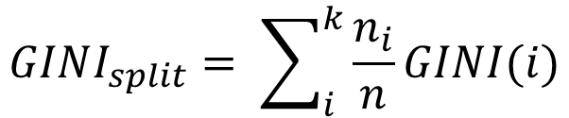
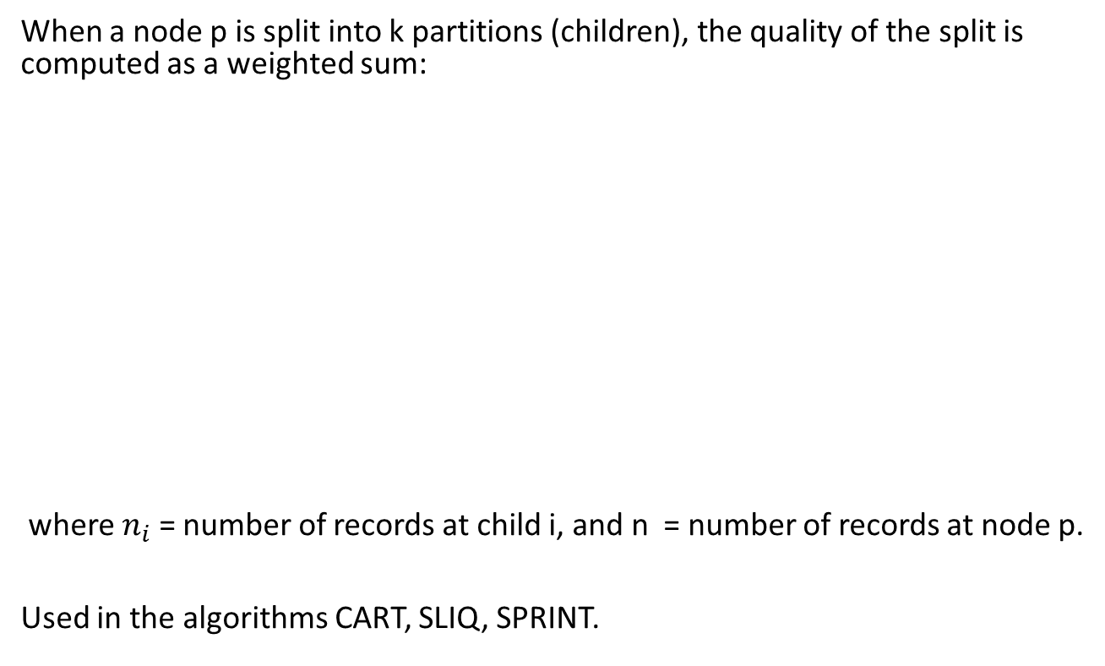
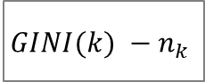
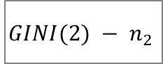
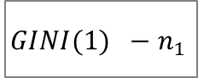
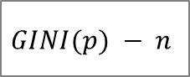
Splitting Based on GINI
When a node p is split into k partitions (children), the quality of the split is computed as a weighted sum:
where $n_{i}$ = number of records at child i, and n = number of records at node p.
Used in the algorithms CART, SLIQ, SPRINT.
$$GINI(p) − n$$
$$GINI(1) −n_{1}$$
$$GINI(2) − n_{2}$$
...
$$GINI(k) −n_{k}$$
$$GINI_{split}= \sum_{i}^{k}{\frac{n_{i}}{n}GINI(i)}$$

Slide 39
Binary Attributes: Computing GINI Index
Splits into two partitions
Effect of weighing partitions: Larger and purer partitions are sought for.
B?
Yes
No
Node N1
Node N2
Gini(N1) = 1 – (5/8)² – (3/8)² = 0.469
Gini(N2) = 1 – (1/4)² – (3/4)² = 0.375
Gini(Children) = 8/12 * 0.469 + 4/12 * 0.375 = 0.438
GINI improves!

Slide 40
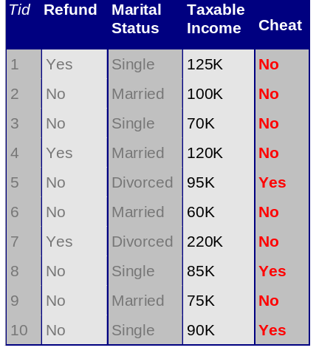
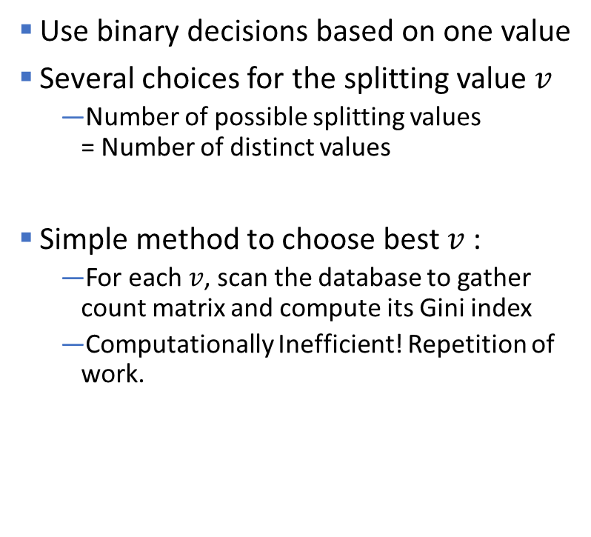
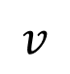
Continuous Attributes: Computing Gini Index
Use binary decisions based on one value
Several choices for the splitting value $v$
Number of possible splitting values = Number of distinct values
Simple method to choose best $v$:
For each $v$, scan the database to gather count matrix and compute its Gini index
Computationally Inefficient! Repetition of work.
$$v$$

Slide 41
Continuous Attributes: Computing Gini Index
For efficient computation: for each attribute,
Sort the attribute on values
Linearly scan these values, each time updating the count matrix and computing gini index
Choose the split position that has the least gini index
Sorted Values
Split Positions

Slide 42
Measures of Node Impurity
Gini Index
Entropy
Classification error

Slide 43
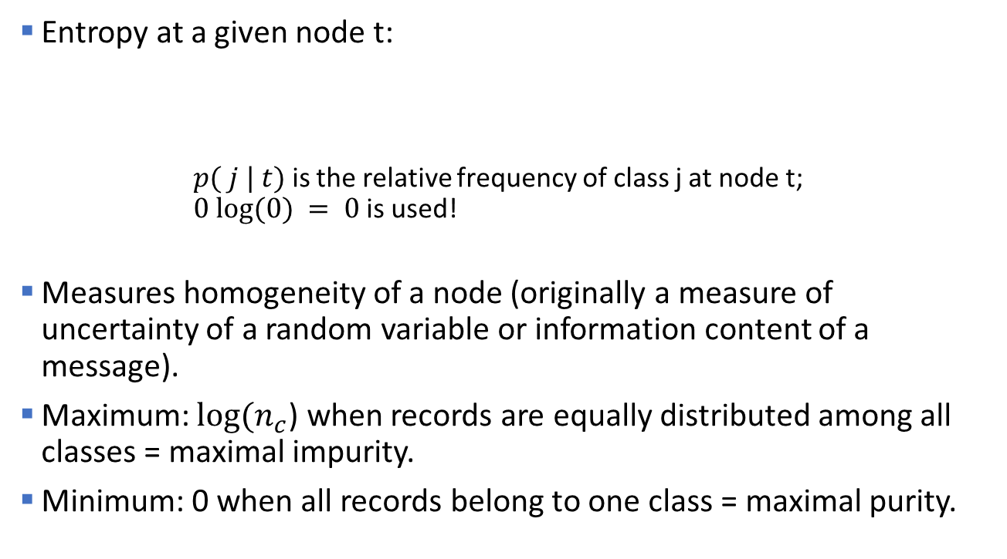
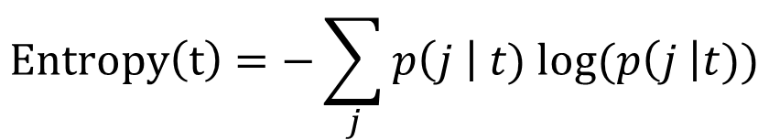
Measure of Impurity: Entropy
Entropy at a given node t:
$p( j | t)$ is the relative frequency of class j at node t; $0 log⁡(0) = 0$is used!
Measures homogeneity of a node (originally a measure of uncertainty of a random variable or information content of a message).
Maximum: $log(n_{c}$) when records are equally distributed among all classes = maximal impurity.
Minimum: 0 when all records belong to one class = maximal purity.
$$Entropy\left(t\right)=−\sum_{j}{p\left(j \right| t) log⁡(p\left(j \right|t))}$$

Slide 44
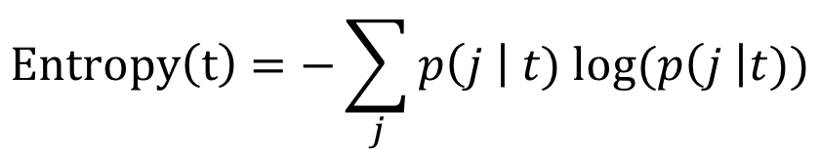
Examples for computing Entropy
$$Entropy\left(t\right)=−\sum_{j}{p\left(j \right| t) log⁡(p\left(j \right|t))}$$
P(C1) = 0/6 = 0 P(C2) = 6/6 = 1
Entropy = – 0 log 0 – 1 log 1 = – 0 – 0 = 0
P(C1) = 1/6 P(C2) = 5/6
Entropy = – (1/6) log₂ (1/6) – (5/6) log₂ (1/6) = 0.65
P(C1) = 3/6 P(C2) = 3/6
Entropy = – (3/6) log₂ (3/6) – (3/6) log₂ (3/6) = 1

Slide 45
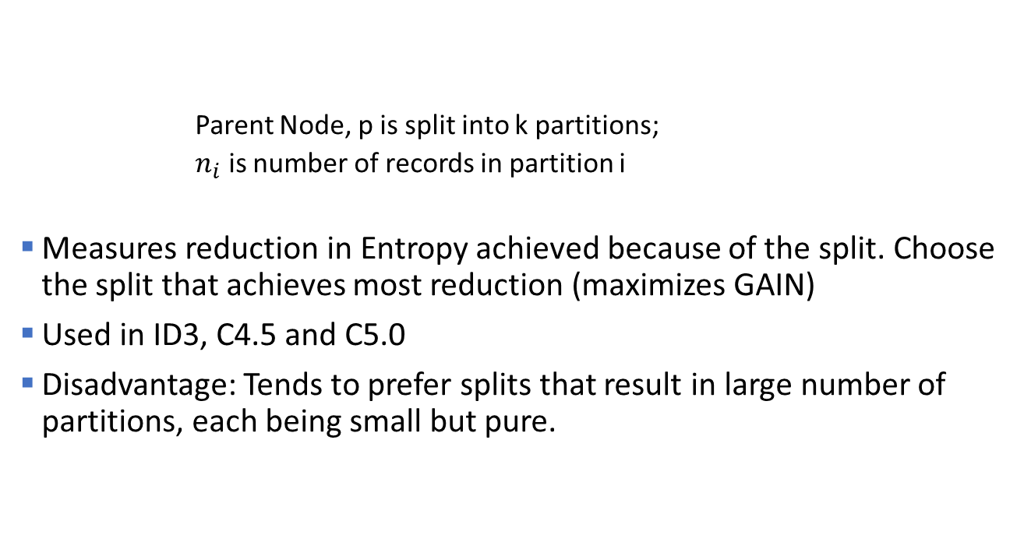
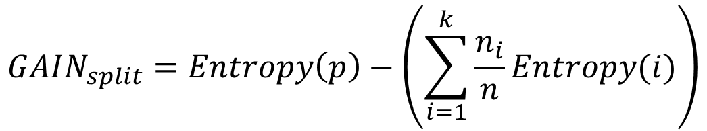
Information Gain
$$GAIN_{split}=Entropy\left(p\right)−\left(\sum_{i=1}^{k}{\frac{n_{i}}{n}Entropy(i)}\right)$$
Parent Node, p is split into k partitions;
$n_{i}$ is number of records in partition i
Measures reduction in Entropy achieved because of the split. Choose the split that achieves most reduction (maximizes GAIN)
Used in ID3, C4.5 and C5.0
Disadvantage: Tends to prefer splits that result in large number of partitions, each being small but pure.

Slide 46
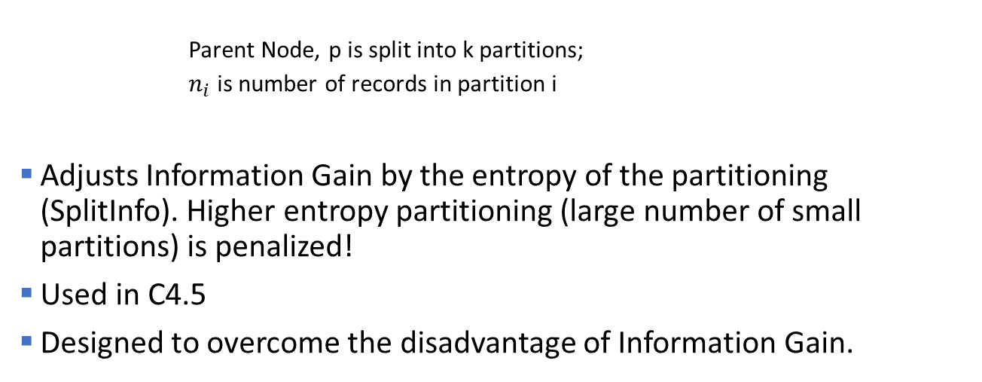
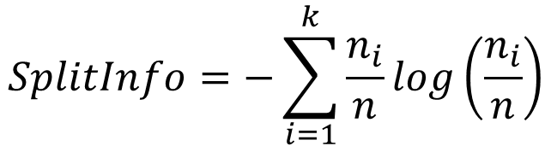
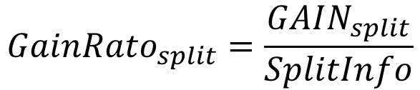
Gain Ratio
$$GainRato_{split}=\frac{GAIN_{split}}{SplitInfo}$$
$$SplitInfo=−\sum_{i=1}^{k}{\frac{n_{i}}{n}log\left(\frac{n_{i}}{n}\right)}$$
Parent Node, p is split into k partitions;
$n_{i}$ is number of records in partition i
Adjusts Information Gain by the entropy of the partitioning (SplitInfo). Higher entropy partitioning (large number of small partitions) is penalized!
Used in C4.5
Designed to overcome the disadvantage of Information Gain.

Slide 47
Measures of Node Impurity
Gini Index
Entropy
Classification error

Slide 48
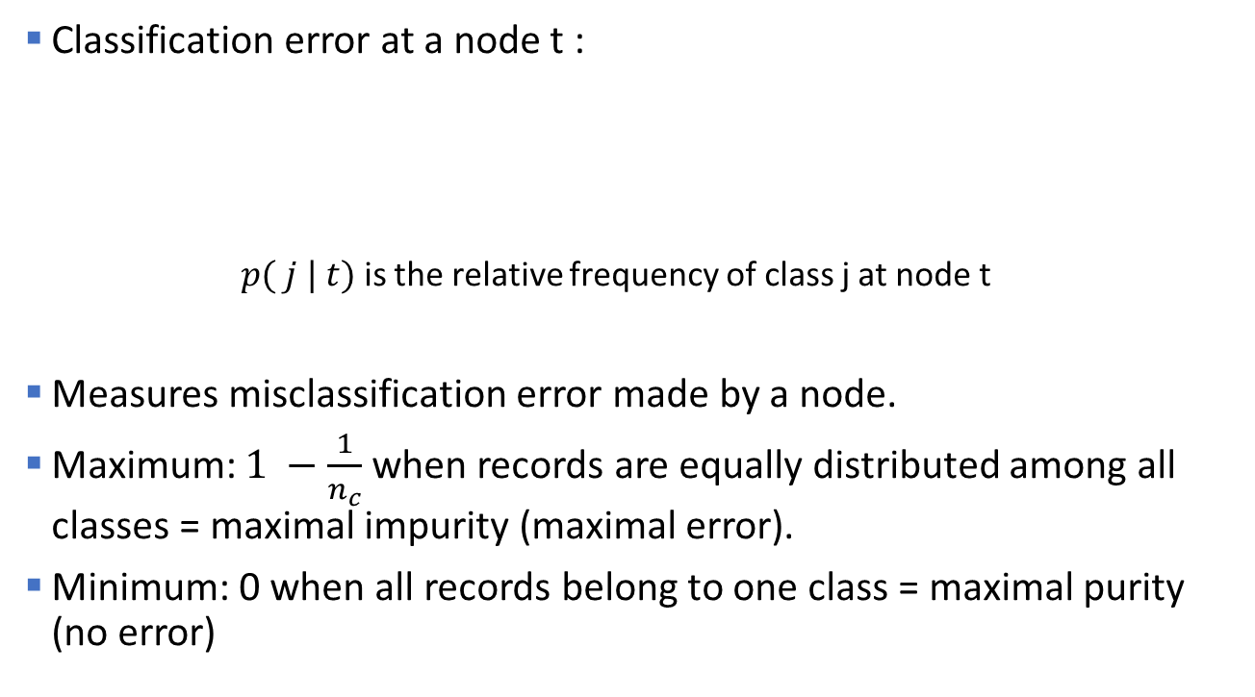
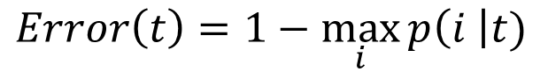
Splitting Criteria based on Classification Error
Classification error at a node t :
$p( j | t)$ is the relative frequency of class j at node t
Measures misclassification error made by a node.
Maximum: $1 −\frac{1}{n_{c}}$when records are equally distributed among all classes = maximal impurity (maximal error).
Minimum: 0 when all records belong to one class = maximal purity (no error)
$$Error\left(t\right)=1−\max_{i}{p\left(i \right|t)}$$

Slide 49
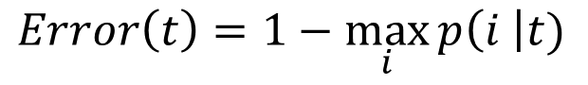
Examples for Computing Error
$$Error\left(t\right)=1−\max_{i}{p\left(i \right|t)}$$
P(C1) = 0/6 = 0 P(C2) = 6/6 = 1
Error = 1 – max (0, 1) = 1 – 1 = 0
P(C1) = 1/6 P(C2) = 5/6
Error = 1 – max (1/6, 5/6) = 1 – 5/6 = 1/6
P(C1) = 3/6 P(C2) = 3/6
Error = 1 – max (3/6, 3/6) = 1 – 3/6 = .5

Slide 50
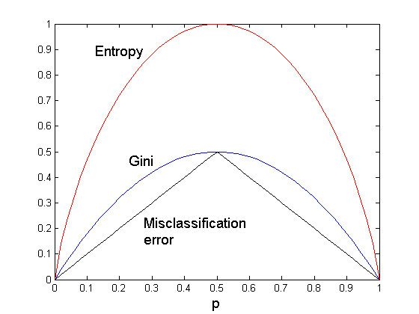
Comparison among Splitting Criteria
For a 2-class problem: Probability of the majority class p is always > .5
Probability of majority class
Note: The order is the same no matter what splitting criterion is used, however, the gain (differences) are not.

Slide 51
Misclassification Error vs Gini
A?
Yes
No
Node N1
Node N2
Gini(N1) = 1 – (3/3)² – (0/3)² = 0 Gini(N2) = 1 – (4/7)² – (3/7)² = 0.489
Gini(Split) = 3/10 * 0 + 7/10 * 0.489 = 0.342
Error(N1) = 1-3/3=0 Error(N2)=1-4/7=3/7
Error(Split)= 3/10*0 + 7/10*3/7 = 0.3
Gini improves! Error does not improve!!!

Slide 52
Tree Induction
Greedy strategy
Split the records based on an attribute test that optimizes a certain criterion.
Issues
Determine how to split the record using different attribute types.
How to determine the best split?
Determine when to stop splitting

Slide 53
Stopping Criteria for Tree Induction
Stop expanding a node when all the records belong to the same class. Happens guaranteed when there is only one observation left in the node (e.g., Hunt's algorithm).
Stop expanding a node when all the records in the node have the same attribute values. Splitting becomes impossible.
Early termination criterion (to be discussed later with tree pruning)

Slide 54
Advantages of Decision Tree Based Classification
Inexpensive to construct
Extremely fast at classifying unknown records
Easy to interpret for small-sized trees
Accuracy is comparable to other classification techniques for many simple data sets

Slide 55
Example: C4.5
Simple depth-first construction.
Uses Information Gain (improvement in Entropy).
Handling both continuous and discrete attributes (cont. attributes are split at threshold).
Needs entire data to fit in memory (unsuitable for large datasets).
Trees are pruned.
Code available at
http://www.cse.unsw.edu.au/~quinlan/c4.5r8.tar.gz
Open Source implementation as J48 in Weka/rWeka

Slide 56
Topics
Introduction
Decision Trees
Overview
Tree Induction
Overfitting and other Practical Issues
Model Evaluation
Metrics for Performance Evaluation
Methods to Obtain Reliable Estimates
Model Comparison (Relative Performance)
Feature Selection
Class Imbalance

Slide 57
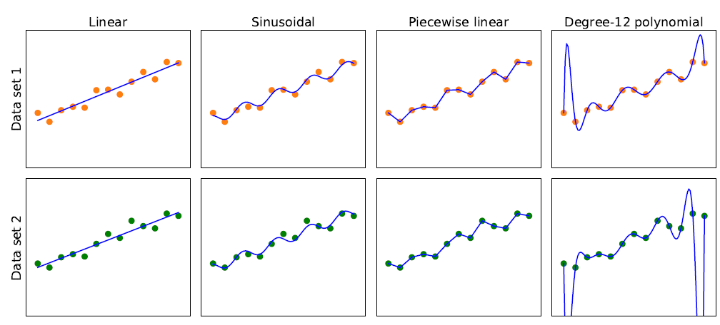
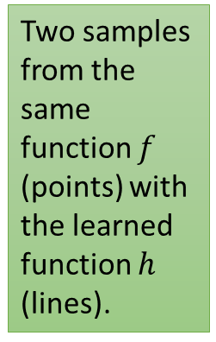
Model Selection: Bias vs. Variance
Overfitting to training data
Simplicity
Consistency
Two samples from the same function $f$ (points) with the learned function $h$ (lines).
High Bias: restrictions by the model class Low
Low Variance: difference in the model due to slightly different data. high
Note: This trade-off applies to any model.

Slide 58
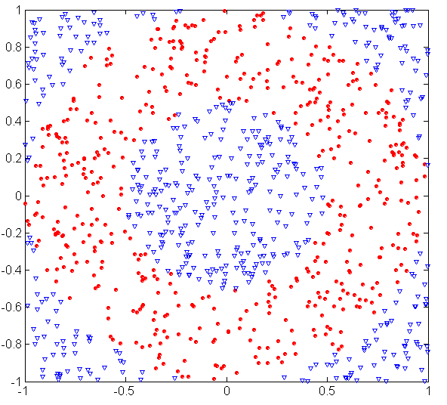
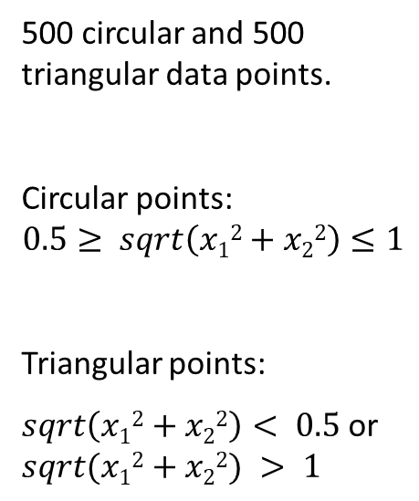
Example: Underfitting and Overfitting
500 circular and 500 triangular data points.
Circular points:
$$0.5≥ sqrt\left(x12+x22\right)≤1$$
Triangular points:
$sqrt\left(x12+x22\right)< 0.5$or $sqrt(x12+x22) > 1$

Slide 59
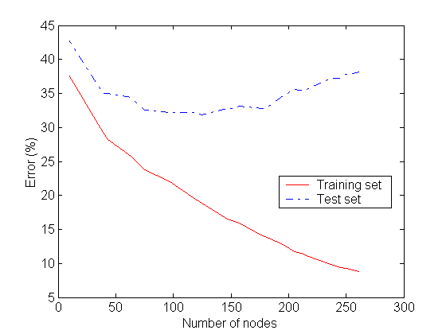
Example: Underfitting and Overfitting
Underfitting
Overfitting
Generalization Error
Resubstitution Error
Underfitting: when model is too simple, both training and test errors are large

Slide 60
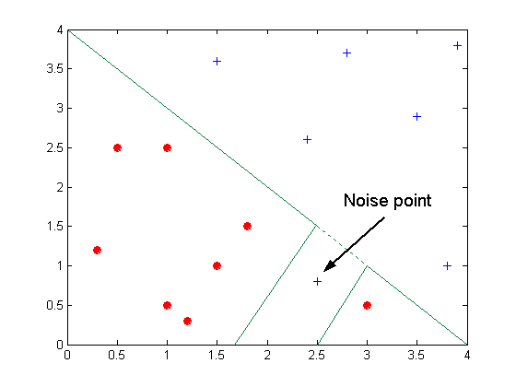
Overfitting due to Noise
Decision boundary is distorted by noise point

Slide 61
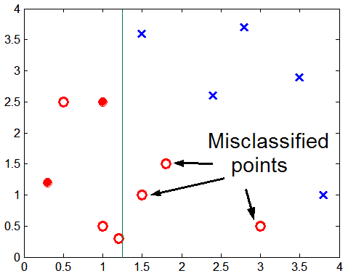
Overfitting due to Insufficient Examples
test
Lack of training data points in the lower half of the diagram makes it difficult to predict correctly the class labels of that region

Slide 62
Generalization Error
Overfitting results in decision trees that are more complex than necessary.
Training error does not provide a good estimate of how well the tree will perform on previously unseen records (e.g., test data).
Need new ways for estimating errors → Generalization Error

Slide 63
Estimating Generalization Errors
Re-substitution errors: error on training set e
Generalization errors: error on testing set e’
Methods for estimating generalization errors:
Optimistic approach: e’ = e
Pessimistic approach:
e’ = e + N x 0.5 (N: number of leaf nodes)
For a tree with 30 leaf nodes and 10 errors on training (out of 1000 instances): Training error (rate) = 10/1000 = 1% Estimated generalization error (rate )= (10 + 30 x 0.5)/1000 = 2.5%
Validation approach:
uses a validation (test) data set (or cross-validation) to estimate generalization error.
Penalty for model complexity!
0.5 per leave node is often used for binary splits.

Slide 64
Occam’s Razor (Principle of parsimony)
"Simpler is better"
Given two models of similar generalization errors, one should prefer the simpler model over the more complex model.
For complex models, there is a greater chance of overfitting (i.e., it fitted accidentally errors in the training data).
Therefore, one should include model complexity when evaluating a model.

Slide 65
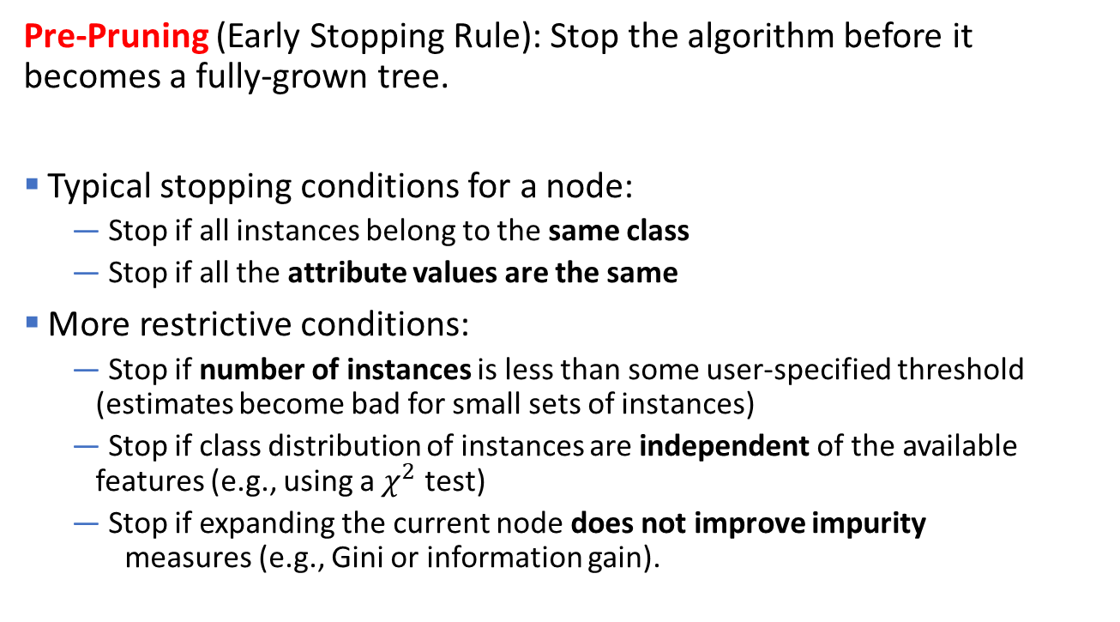
How to Address Overfitting in Decision Trees
Pre-Pruning (Early Stopping Rule): Stop the algorithm before it becomes a fully-grown tree.
Typical stopping conditions for a node:
Stop if all instances belong to the same class
Stop if all the attribute values are the same
More restrictive conditions:
Stop if number of instances is less than some user-specified threshold (estimates become bad for small sets of instances)
Stop if class distribution of instances are independent of the available features (e.g., using a $χ^{2}$ test)
Stop if expanding the current node does not improve impurity measures (e.g., Gini or information gain).

Slide 66
How to Address Overfitting in Decision Trees
Post-pruning
Grow decision tree to its entirety
Try trimming sub-trees of the decision tree in a bottom-up fashion
If generalization error improves after trimming a sub-tree, replace the sub-tree by a leaf node (class label of leaf node is determined from majority class of instances in the sub-tree)
You can use MDL instead of error for post-pruning

Slide 67
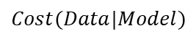
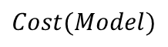
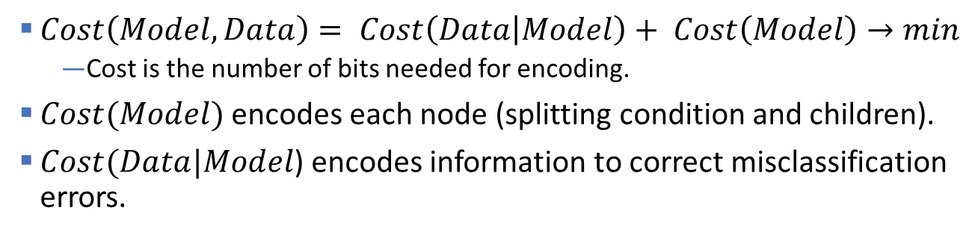
Refresher: Minimum Description Length (MDL)
$$Cost(Model)$$
mistakes
$$Cost(Data|Model)$$
$Cost\left(Model,Data\right)= Cost\left(Data | Model\right)+ Cost\left(Model\right)→min$
Cost is the number of bits needed for encoding.
$Cost(Model)$encodes each node (splitting condition and children).
$Cost(Data|Model$) encodes information to correct misclassification errors.

Slide 68
Example of Post-Pruning
Before split: Training Error = 10/30 Pessimistic error = (10 + 1 x 0.5)/30 = 10.5/30
After split: Training Error = 9/30 Pessimistic error = (9 + 4 x 0.5)/30 = 11/30
Pessimistic error increases! PRUNE!
Class = Yes | 20
Class = No | 10
Error = 10/30
Class = Yes | 8
Class = No | 4
Class = Yes | 3
Class = No | 4
Class = Yes | 4
Class = No | 1
Class = Yes | 5
Class = No | 1
Error = 9

Slide 69
Other issues: Data Fragmentation and Search Strategy
Data Fragmentation
Number of instances gets smaller as you traverse down the tree and can become too small to make a statistically significant decision (splitting or determining the class in a leaf node)
→ Many algorithms stop when a node has not enough instances.
Search Strategy
Finding an optimal decision tree is NP-hard
→ Most algorithm use a greedy, top-down, recursive partitioning strategy to induce a reasonable solution.

Slide 70
Other issues: Tree Replication
Same subtree appears in multiple branches
Makes the model more complicated and harder to interpret

Slide 71
Expressiveness of Decision Trees
Decision tree can learn discrete-valued functions to separate classes.
This function represents the decision boundary.
Issues
Not expressive enough for modeling continuous variables directly (need to be discretized for the split).
Do not generalize well to certain types of Boolean functions like the parity function (Class = 1 if there is an even number of Boolean attributes with truth value = True and 0 otherwise). These functions lead to excessive tree replication.

Slide 72
Decision Boundary
Border line between two neighboring regions of different classes is known as decision boundary
Decision boundary is parallel to axes because test condition involves a single attribute at-a-time

Slide 73
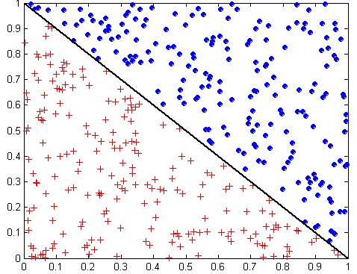
Oblique Decision Trees
x + y < 1
Class = +
Class =
Test condition may involve multiple attributes
More expressive representation
Finding optimal test condition is computationally expensive -> Not used in practice.

Slide 74

Topics
Introduction
Decision Trees
Overview
Tree Induction
Overfitting and other Practical Issues
Model Evaluation
Metrics for Performance Evaluation
Methods to Obtain Reliable Estimates
Model Comparison (Relative Performance)
Feature Selection
Class Imbalance

Slide 75
Metrics for Performance Evaluation: Confusion Matrix
Focus on the predictive capability of a model (not speed, scalability, etc.)
Here we will focus on binary classification problems!
Confusion Matrix
 | PREDICTED CLASS
ACTUAL CLASS |  | Class=Yes | Class=No
 | Class=Yes | a (TP) | b (FN)
 | Class=No | c (FP) | d (TN)
a: TP (true positive)
b: FN (false negative)
c: FP (false positive)
d: TN (true negative)

Slide 76
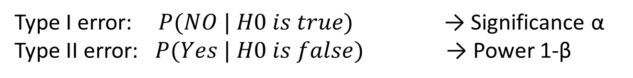
Metrics for Performance Evaluation: Statistical Test
From Statistics: Null Hypotheses H0 is that the actual class is yes
 | PREDICTED CLASS
ACTUAL CLASS |  | Class=Yes | Class=No
 | Class=Yes |  | Type I error
 | Class=No | Type II error
Type I error: $P(NO | H0 is true)$ → Significance α
Type II error: $P(Yes | H0 is false)$ → Power 1-β

Slide 77
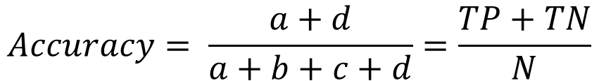
Metrics for Performance Evaluation: Accuracy
Most widely-used metric: How many do we predict correct (in percent)?
 | PREDICTED CLASS
ACTUAL CLASS |  | Class=Yes | Class=No
 | Class=Yes | a (TP) | b (FN)
 | Class=No | c (FP) | d (TN)
$$Accuracy= \frac{a+d}{a+b+c+d}=\frac{TP+TN}{N}$$

Slide 78
Limitation of Accuracy
Consider a 2-class problem
Number of Class 0 examples = 9990
Number of Class 1 examples = 10
If model predicts everything to be class 0, accuracy is 9990/10000 = 99.9 %
Accuracy is misleading because the model does not detect any class 1 example
→ Class imbalance problem!

Slide 79
Cost Matrix
Different types of error can have different cost!
 | PREDICTED CLASS
ACTUAL CLASS | C(i|j) | Class=Yes | Class=No
 | Class=Yes | C(Yes|Yes) | C(No|Yes)
 | Class=No | C(Yes|No) | C(No|No)
C(i|j): Cost of misclassifying class j example as class i

Slide 80
Computing Cost of Classification
Cost Matrix | PREDICTED CLASS
ACTUAL CLASS | C(i|j) | + | -
 | + | -1 | 100
 | - | 1 | 0
Missing a + case is really bad!
Model M₁ | PREDICTED CLASS
ACTUAL CLASS |  | + | -
 | + | 150 | 40
 | - | 60 | 250
Model M₂ | PREDICTED CLASS
ACTUAL CLASS |  | + | -
 | + | 250 | 45
 | - | 5 | 200
Accuracy = 80%
Cost = -1*150+100*40+ 1*60+0*250 = 3910
Accuracy = 90%
Cost = 4255

Slide 81
Cost vs Accuracy
Count | PREDICTED CLASS
ACTUAL CLASS |  | Class=Yes | Class=No
 | Class=Yes | a | b
 | Class=No | c | d
Accuracy is only proportional to cost if 1. C(Yes|No)=C(No|Yes) = q 2. C(Yes|Yes)=C(No|No) = p
N = a + b + c + d
Accuracy = (a + d)/N
Cost = p (a + d) + q (b + c)
= p (a + d) + q (N – a – d)
= q N – (q – p)(a + d)
= N [q – (q-p) x Accuracy]
Cost | PREDICTED CLASS
ACTUAL CLASS |  | Class=Yes | Class=No
 | Class=Yes | p | q
 | Class=No | q | p

Slide 82
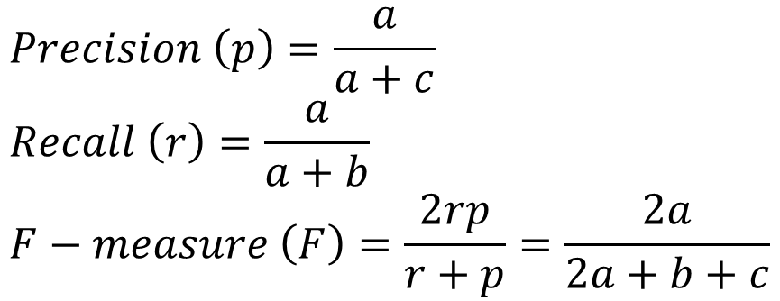
Cost-Biased Measures
 | PREDICTED CLASS
ACTUAL CLASS |  | Class Yes | Class No
 | Class Yes | a (TP) | b (FN)
 | Class No | c (FP) | d (TN)
$$Precision \left(p\right)=\frac{a}{a+c} \\ Recall \left(r\right)=\frac{a}{a+b} \\ F−measure \left(F\right)=\frac{2rp}{r+p}=\frac{2a}{2a+b+c}$$
Precision is biased towards C(Yes|Yes) & C(Yes|No)
Recall is biased towards C(Yes|Yes) & C(No|Yes)
F-measure is biased towards all except C(No|No)

Slide 83

Kappa Statistic
 | PREDICTED CLASS
ACTUAL CLASS |  | Class Yes | Class No
 | Class Yes | a (TP) | b (FN)
 | Class No | c (FP) | d (TN)
Idea: Compare the accuracy of the classifier with a random classifier. The classifier should be better than random!
$$κ=\frac{total accuracy −random accuracy}{1 −random accuracy} \\ total accuracy=\frac{TP+TN}{N} \\ random accuracy=\frac{TP+FP×TN+FN+FN+TN×FP+TP}{N^{2}}$$

Slide 84
ROC (Receiver Operating Characteristic)
Developed in 1950s for signal detection theory to analyze noisy signals to characterize the trade-off between positive hits and false alarms.
Works only for binary classification (two-class problems). The classes are called the positive and the other is the negative class.
ROC curve plots TPR (true positive rate) on the y-axis against FPR (false positive rate) on the x-axis.
Performance of each classifier represented as a point. Changing the threshold of the algorithm, sample distribution or cost matrix changes the location of the point and forms a curve.

Slide 85


ROC Curve
Example with 1-dimensional data set containing 2 classes (positive and negative)
Any points located at x > t is classified as positive
Prob
TPR=0.5
At threshold t:
TPR=0.5, FNR=0.5, FPR=0.12, FNR=0.88
FPR=0.12
Move t to get the other points on the ROC curve.

Slide 86
ROC Curve
Ideal classifier
(TPR,FPR):
(0,0): declare everything to be negative class
(1,1): declare everything to be positive class
(1,0): ideal
Diagonal line:
Random guessing
Below diagonal line: prediction is opposite of the true class

Slide 87

Using ROC for Model Comparison
No model consistently outperform the other
M1 is better for small FPR
M2 is better for large FPR
Area Under the ROC curve (AUC)
Ideal:
AUC = 1
Random guess:
AUC = 0.5

Slide 88
Topics
Introduction
Decision Trees
Overview
Tree Induction
Overfitting and other Practical Issues
Model Evaluation
Metrics for Performance Evaluation
Methods to Obtain Reliable Estimates
Model Comparison (Relative Performance)
Feature Selection
Class Imbalance

Slide 89

Learning Curve
Accuracy and variance between runs depend on the size of the training data.
Learning curve shows how accuracy on unseen examples changes with varying training sample size
Variance for several runs
Training data (log scale)

Slide 90
Training and Test Data
Separate data into a set to train and a set to test.
Holdout testing/Random splits: Split the data randomly into, e.g., 80% training and 20% testing.
k-fold cross validation: Use training & validation data better
split the training & validation data randomly into k folds.
For k rounds hold 1 fold back for testing and use the remaining k-1 folds for training.
Use the average the error/accuracy as a better estimate.
Some algorithms/tools do that internally.
LOOCV (leave-one-out cross validation): k = n used if very little data is available.
Very important: the algorithm can never look at the test set during learning!
Training
Data
Test
Data

Slide 91
Training and Testing with Hyperparameters
Hyperparameters: Many algorithms allow choices for learning. E.g.,
maximal decision tree depth
selected features
Train: Learn models on the training data (without the validation data) using different hyperparameters.
A grid of possible hyperparameter combinations
greedy search
Model Selection: Evaluate the models using the validation data and choose the hyperparameters with the best accuracy. Rebuild the model using all the training data.
Test the final model using the test data.
Training
Data
Validation
Data
Test
Data

Slide 92
How to Split the Dataset
Random splits: Split the data randomly in 60% training, 20% validation, and 20% testing.
k-fold cross validation: Use training & validation data better
split the training & validation data randomly into k folds.
For k rounds hold 1 fold back for testing and use the remaining k-1 folds for training.
Use the average the error/accuracy as a better estimate.
Some algorithms/tools do that internally.
Training
Data
Validation
Data
Test
Data

Slide 93


Confidence Interval for Accuracy
Each prediction can be regarded as a Bernoulli trial: A Bernoulli trial (a biased coin toss) has 2 possible outcomes: heads (correct) or tails (wrong) We use $p$ for the true chance that prediction is correct (= true accuracy).
Predictions for a test set of size $N$ are a collection of N Bernoulli trials. The number of correct predictions $x$ has a Binomial distribution:
$$X \sim Binomial\left(N, p\right)$$ Example: Toss a fair coin 50 times, how many heads would turn up? Expected number of heads $E[X]= Np = 50× 0.5 = 25$
Given we observe $x$ correct predictions (an observed accuracy of $\hat{p}=x/N$): Can we give bounds for the true accuracy of model $p$?

Slide 94





Confidence Interval for Accuracy
$$Area = 1 −α$$
For large test sets ($N > 30$) we can approximate the Binomial distribution by a Normal distribution:
$$X \sim Normal(Np, Np\left(1−p\right))$$
Confidence Interval for $p=X/N$(Wald Method):
$$\hat{p}±z_{α/2}\sqrt{\frac{\hat{p}\left(1−\hat{p}\right)}{N}}$$
$$−z_{α/2}$$
$$z_{α/2}$$

Slide 95




Confidence Interval for Accuracy
Consider a model that produces an accuracy of 80% when evaluated on 100 test instances:
N = 100, acc = 0.8
Let $1−α= 0.95$(95% confidence)
From probability table, $z_{α/2} =1.96$
$$1−α/2$$ | $$z_{α/2}$$
0.99 | 2.58
0.98 | 2.33
0.95 | 1.96
0.90 | 1.65
$$\hat{p}±z_{α/2}\sqrt{\frac{\hat{p}\left(1−\hat{p}\right)}{N}}$$
N | 50 | 100 | 500 | 1000 | 5000
p(lower) | 0.689 | 0.722 | 0.765 | 0.775 | 0.789
p(upper) | 0.911 | 0.878 | 0.835 | 0.825 | 0.811
Table or R $qnorm(1−α/2)$

Slide 96
Topics
Introduction
Decision Trees
Overview
Tree Induction
Overfitting and other Practical Issues
Model Evaluation
Metrics for Performance Evaluation
Methods to Obtain Reliable Estimates
Model Comparison (Relative Performance)
Feature Selection
Class Imbalance

Slide 97

Comparing Performance between 2 Models
Given two models, say $M_{1}$ and $M2$, which is better?
For large test sets ($N > 30$) we have approximately:
$$acc_{1} \sim Normal(p_{1},{Np}_{1}\left(1−p_{1}\right))$$
$$acc_{2} \sim Normal(p_{2},{Np}_{2}(1−p_{2}))$$
Perform a paired t-test with:
H0: There is no difference in accuracy between the models.
H1: There is a difference.
Comparing multiple models: You need to correct for multiple comparisons! For example using Bonferroni correction.

Slide 98

Topics
Introduction
Decision Trees
Overview
Tree Induction
Overfitting and other Practical Issues
Model Evaluation
Metrics for Performance Evaluation
Methods to Obtain Reliable Estimates
Model Comparison (Relative Performance)
Feature Selection
Class Imbalance

Slide 99
Feature Selection
What features should be used in the model?
Univariate feature importance score
measures how related each feature is to the class variable.
Feature subset selection
tries to find the best set of features.
E.g., chi-squared statistic, information gain.
Often uses a black box approach where different subsets are evaluated using a greedy search strategy.

Slide 100

Topics
Introduction
Decision Trees
Overview
Tree Induction
Overfitting and other Practical Issues
Model Evaluation
Metrics for Performance Evaluation
Methods to Obtain Reliable Estimates
Model Comparison (Relative Performance)
Feature Selection
Class Imbalance

Slide 101

Class Imbalance Problem
Consider a 2-class problem
Number of Class 0 examples = 9990
Number of Class 1 examples = 10
A simple model:
Always predict Class 0
accuracy = 9990/10000 = 99.9 %
error = 0.1%
Issues:
Evaluation: accuracy is misleading.
Learning: Most classifiers try to optimize accuracy/error. These classifiers will not learn how to find examples of Class 1!

Slide 102
Class Imbalance Problem: Evaluation
Do not use accuracy to evaluate for problems with strong class imbalance!
Use instead:
ROC curves and AUC (area under the curve)
Precision/Recall plots or the F1 Score
Cohen's Kappa
Misclassification cost

Slide 103

Class Imbalance Problem: Learning
Do nothing. Sometimes you get lucky!
Balance the data set: Down-sample the majority class and/or up-sample the minority class (use sampling with replacement). Synthesize new examples with SMOTE. This will artificially increase the error for a mistake in the minority class.
Use algorithms that can deal with class imbalance (see next slide).
Throw away minority examples and switch to an anomaly detection framework.

Slide 104
Class Imbalance Problem: Learning
Algorithms that can deal with class imbalance:
Use a classifier that predict a probability and lower the decision threshold (from the default of .5). We can estimate probabilities for decision trees using the positive and negative training examples in each leaf node.
Use a cost-sensitive classifier that considers a cost matrix (not too many are available).
Use boosting techniques like AdaBoost.

Slide 105

Conclusion
Classification is supervised learning with the goal to find a model that generalizes well.
Generalization error can be estimated using test sets/cross-validation.
Model evaluation and comparison needs to take model complexity into account.
Accuracy is problematic for imbalanced data sets.

